Slide 1
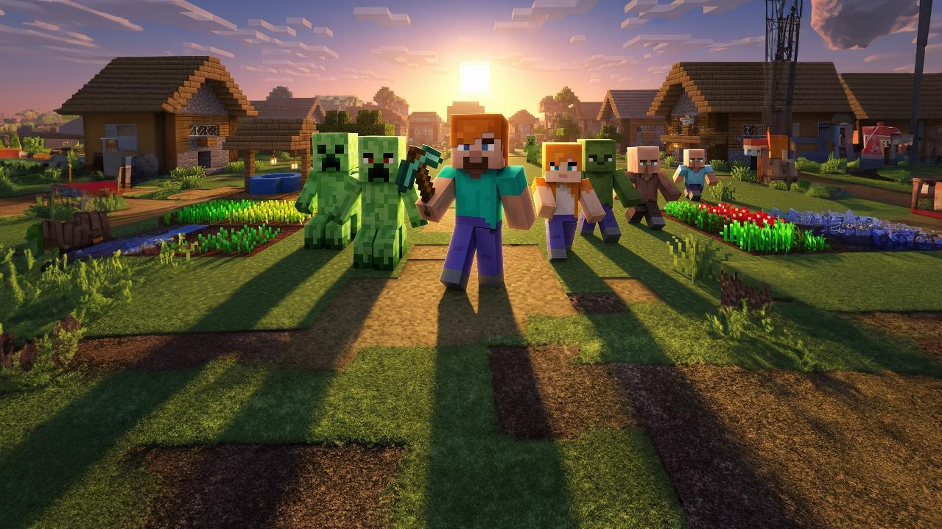





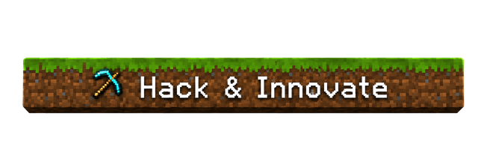




We Learn, We Teach, We Conquer!
INDRADHANU
Offline Disaster Management Agentic System
Track: Agentic AI · Disaster management that keeps working with zero internet
Team lead: Ayush Pathak
TEAM KALA DHUA
Ayush Pathak · Shreeviraj Matale · Tushar Singh
Vishwakarma Institute of Technology
1

Slide 2
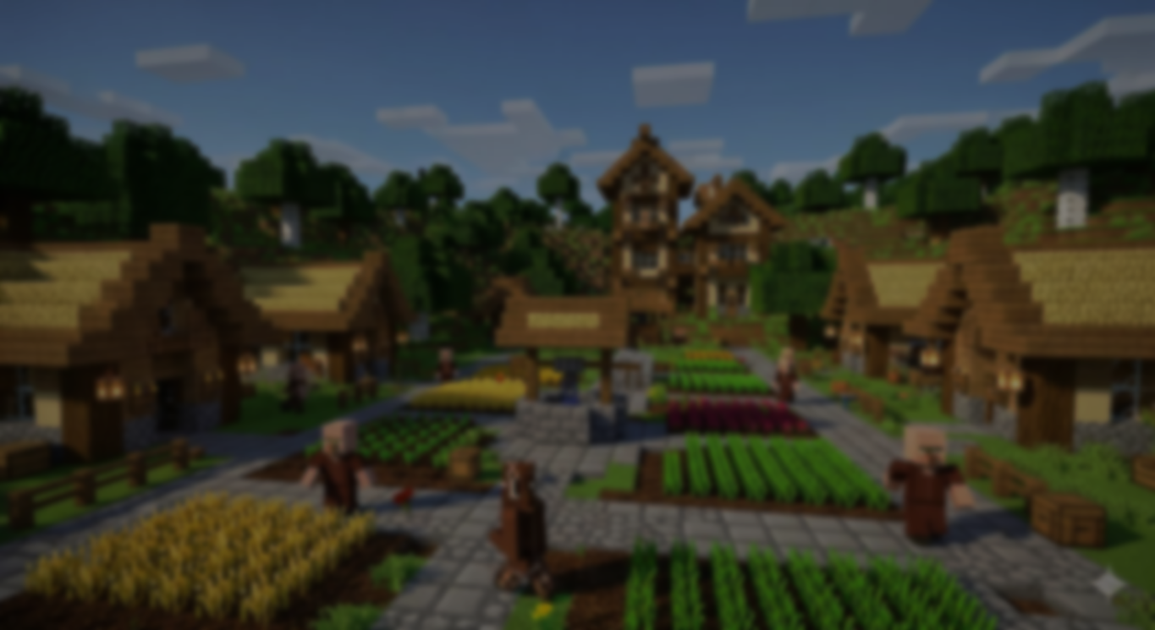






PROBLEM STATEMENT
When a disaster hits, the network fails first, and response goes blind
Floods take out towers and power. Control rooms lose the ground picture exactly when they need it most.
Hindon floods, Ghaziabad · July 2023
Why response goes wrong today
2,000+
1,000+
800
The network goes down first
SOS calls can't get out and the control room goes blind.
families affected
people evacuated
sheltered in one school
Reports can't be trusted
Roads closed and power cut across 10+ colonies, right next to our IPEC test area.
Late, duplicated or fake: ten calls about one street, none verified.
“The commanding officer cannot communicate with his own team.”
Crews hit blocked roads
Road status never reaches dispatch, so teams are sent the wrong way.
NDRF officer, J&K super-flood 2014 · 1 million+ people affected
No record of why
Towers underwater
Power down
Decisions happen on phone calls; afterwards nobody can audit them.
Sources: Sphere India SitRep (24 Jul 2023); GSMA Mobile for Humanitarian Innovation
2

Slide 3




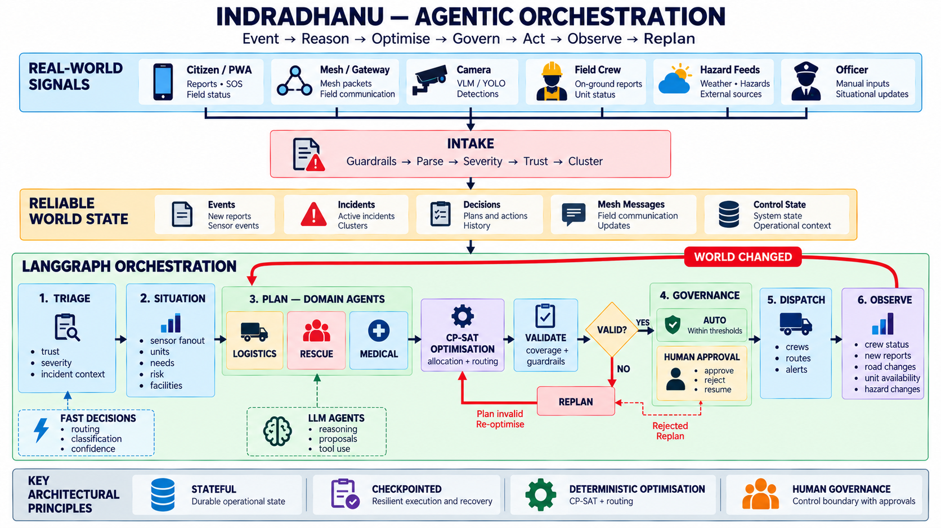
PROPOSED SOLUTION
Indradhanu keeps disaster response running with zero internet
Phones form an offline mesh, AI agents plan, and the right team reaches the right street by an open road.
1 Sense
2 Verify
3 Plan
4 Adapt
Offline mesh
AI / ML
AI agents
Closed loop
Citizens, crews and cameras report over a Bluetooth mesh; no signal needed.
Trust score and severity from the words; fakes quarantined, duplicates merged.
LangGraph agents + CP-SAT pick the nearest right units; officer approves.
Road blocked or new SOS: re-plans in seconds, orders go back over the mesh.
How the agents work · event → reason → optimise → govern → act → re-plan
What it does, measured on the live system
384/384
dispatch routes on real roads, around 20 reported road blocks
2.8%
reports quarantined as untrustworthy (10 of 362)
347
incidents handled end-to-end, 30 wards across Pune and Ghaziabad
3

Slide 4

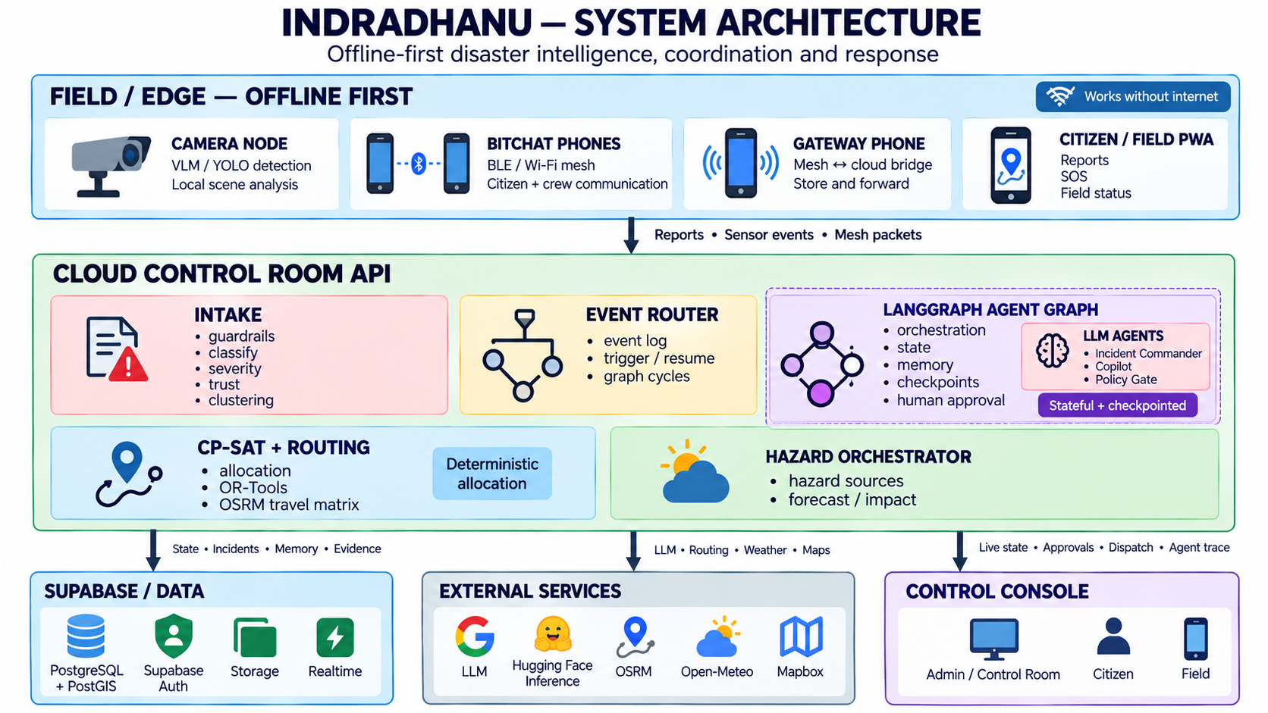






TECH STACK
Offline edge, agentic core, one shared picture for everyone
Edge (offline)
* ARCH. DIAGRAM
bitchat Android BLE mesh · YOLO + Qwen2.5-VL camera node · gateway phone
AI & agents
LangGraph (contracts, guardrails, scoped memory) · OR-Tools CP-SAT · XLM-R · Gemini
Backend
FastAPI (Python) · asyncpg · event router · Mapbox / OSRM routing
Data
Supabase Postgres + PostGIS, realtime · Open-Meteo · GloFAS
Frontend
React + Vite · Mapbox GL · offline PWA (citizen, field, control room)
Deploy
Works without internet
Every decision explained
Vercel · Render · Supabase; state data centre + on-prem LLM in production
the mesh carries reports and orders
logged with its reason; officer approves
4

Slide 5




BUSINESS PLAN
Sold to the agencies that already fund disaster response
Start with one flood-prone district, prove faster rescues in a monsoon, then scale state by state.
How it makes money
Roadmap
₹2.29 lakh crore
Annual subscription per district for the control room, agents and copilot
Paid monsoon pilot before a state-wide contract
Mesh kits at cost + setup gateway phones, camera nodes, training
Citizen and mesh apps stay free so every SOS gets through
Done
Live platform, mesh app, camera node; running in Pune and Ghaziabad
set aside for disaster response and relief in India, 2021–26 (15th Finance Commission)
Next 3 months
Who buys
Monsoon drills with college and ward teams
State & district disaster authorities (SDMA, DDMA) and their control rooms
Municipal corporations for monsoon and urban flooding
NDRF / SDRF battalions coordinating field teams
Later: campuses, industrial parks, insurers, relief NGOs
Why it can win
6 months
Works offline: nothing else keeps running when towers fall
Runs on phones people already carry
On-prem ready: data stays with the state
Builds on IMD / GloFAS, nothing to replace
District pilot on a state data centre, on-prem LLM
12 months
State-wide rollout; plug into SDMA systems
5

Slide 6





THANK YOU
When the network falls, Indradhanu still gets help to the right street.
Live demo
Citizen app (no login)
Command wall
distro-ruddy.vercel.app
distro-ruddy.vercel.app/citizen
distro-ruddy.vercel.app/admin/wall
Demo video
Source code
Mesh + VLM code
drive.google.com (demo folder)
github.com/officialayush23/DisruptionOps
github.com/officialayush23/kurukshetra_hackathon
Team Kala Dhua · Ayush Pathak, Shreeviraj Matale, Tushar Singh· officialayushp123@gmail.com
6

